Slide 1
Descriptive Analytics using Python
Notes:
Notes:
Do: <Explain what the facilitator needs to do.>.
Tell: <Summarize what the facilitator needs to say.>
Ask: <List the question/s the facilitator should ask the participants.>
Expected Responses: <List the responses facilitator might get from the participants on the asked question/s.>
Show: <List what the facilitator needs to show.>

Slide 2
CONTENTS
Over view to Descriptive analytics
Data preparations
Handle missing values
Data visualizations

Slide 3
Descriptive analytics: Example –IPL Data set
The IPL is professional cricket t20 league championship started in India in 2008. It was initiated by BCCI with 8 franchises comprising players across the world. The first IPL auction was held in 2008 for ownership of the teams for 10 years, with base price of USD 50 Billion. The performance of the players could be measured many ways. The data set consist of performance 0f 130 players measured through various performance measure metrics such as batting , bowling etc Science of describing the past data
Data set name: IPL IMB381IPL2013.CSV

Slide 4
Descriptive analytics: Example –IPL Data set
Pandas is an open source BSD (Berkeley software distribution) licensed library providing high performance , easy to use data structures and data analysis tool for python programming language.
Pandas imported as pd
Steps
Loading data set
Displaying records
Summary of data frame
Slicing and indexing of data frame : Creating subsets for further findings. The row and column indexes always start with value o
value count and cross tabulations: value_counts() and cross tabulation will help find occurrence of values for two columns.

Slide 5
Descriptive analytics: Example –IPL Data set
Steps
Sorting data frame by column values : sort_values() –takes the column names to be sorted
Creating new columns: Create new features from the existing features by arithmetical operations ..example-Premium player based on base price and sold price
Grouping and aggregating: To group records based on the column values and then apply aggregated operations such as mean, maximum etc. … example-Average sold price for each age category, group all records by age and then apply mean() on sold price columns
Joining DF: can combine feature of multiple df using pandas merge()
Renaming the columns: rename(), for renaming multiple columns simultaneously ,the method can take a dictionary as a parameter , where the keys should be existing column names and the values should be the new names to be assigned

Slide 6
Descriptive analytics: Example –IPL Data set
Steps
Applying operations to multiple columns: Example-its iterated through each row in the Dataframe and then apply the above calculations to the columns . The resulting value should be added as a new columns to the existing df . The function apply() can apply a function along any axis of a df
Filtering records based on condition-Using indexing mechanism. Those records for which the condition returns TRUE are selected to be part of the resulting df.
Removing columns or row : drop(), it takes a parameter axis to specify if a column or row to be removed. Column-axis 1, row axis as 0
Handling missing values:

Slide 7
Descriptive analytics: Example –mtcars
Steps
Handling missing values:
Remove from data set
Impute the data (process of filling the missing values)
Filtering records based on condition-Using indexing mechanism.

Slide 8
Exploration of Data using visualization
Gain insight to understand the data
Helpful for feature engineering
Drawing plots
Library: matplotlib (python 2d plotting library which provides extensive set of APIs to create various plots such as scattered, bar, box and distribution plots with custom styling and annotation
Seaborn is also a python visualization library based on matplotlib
To create graphs and plots we need to import matplotlib.pyplot and seaborn modules
To display plots on the Jupyter notebook , we need to provide a directive %matplotlib.inline (directive)

Slide 9
Exploration of Data using visualization
Bar chart sn barplot()
Frequency chart for qualitative variable (categorical variable)
Can identify most occurring & least occurring categories within data set
To draw chart, call barplot() of a seaborn library
3rd parameter :hue
Histogram hist()
Frequency distributions of a set of continuous variable
Histogram gives an insight in to the underlying distribution of variable, outliers, skewness etc
Distribution or Density plot (displot())
Plot depicts the distribution of data over a continuous interval
It’s a smoothed histogram & visualizes distribution of data over a continuous interval.
Also gives insight to what might be the distribution of population

Slide 10
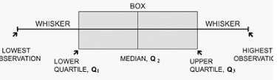
Exploration of Data using visualization
Box plots (Aka box and Whisker plot) ….snboxplot()
Representation of numerical data that can be used to understand the variability of data and existence of outliers
It designed by identifying the following descriptive statistics
Lower quartile (1st quartile), median and upper quartile (3rd quartile)
Lowest and highest values
Inter quartile range (IQR)- Difference b/w Lower quartile and upper quartile
Scatter plots
Two variable plot along 2 axis and resulting pattern can be reveal correlation present b/w variables
Relation can be linear or non linear
Useful for assessing the strength of relationship to find if there are outliers
Q1-1.5 IQR
Q3+1.5 IQR

Slide 11
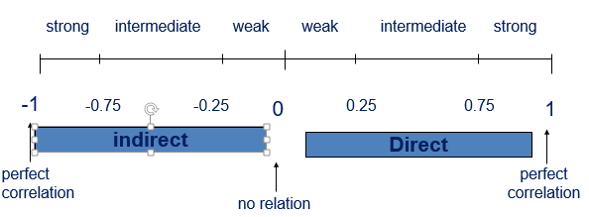
Exploration of Data using visualization
Pair Plot
For identifying the relationship among many variables
Depict the relationship in a single diagram using pairpolt()
Correlation & Heat Map… using corr()
Correlation used for measuring strength and direction of linear relationship between the continuous RV X & Y
It’s a statistical measure that indicates the extent to which two variables change together
A Positive correlation means the variable increase or decrease together, A negative correlation means if one variable increases the other decreases.

Slide 12
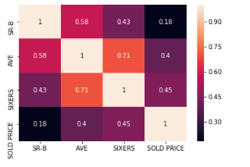
Exploration of Data using visualization
Heat Map… using heatmap()
Color map scale of correlation
Setting annote attribute to true prints the correlation values in each box of the heat map and improves the readability of the heat map

